Slide 1

Quant Week 3
9/24/25
Notes:
Complete

Slide 2

Ice Breaker
Who slept the longest?

Slide 3
Ice Breaker
Who slept the longest?

Slide 4
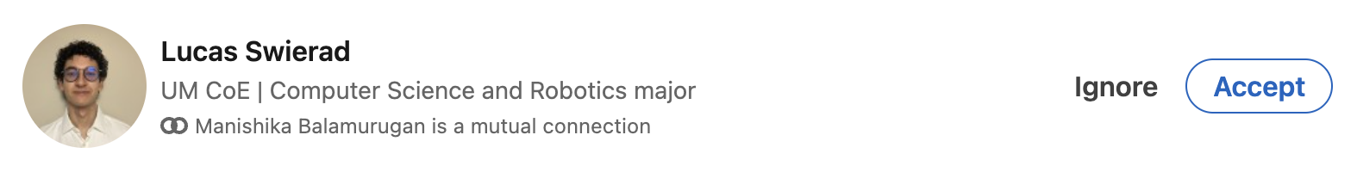
Spotlight

Slide 5
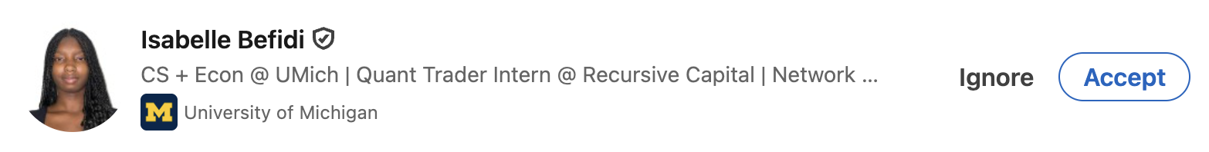
Spotlight

Slide 6
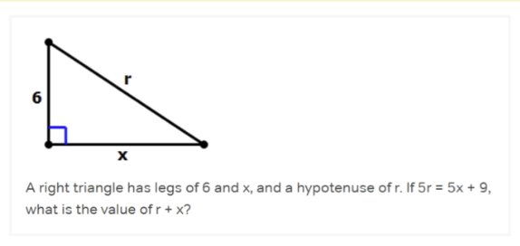
Geometry Warm Up

Slide 7
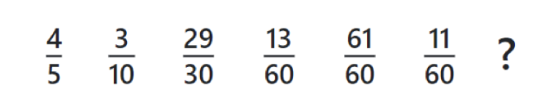
Weekly Sequence

Slide 8
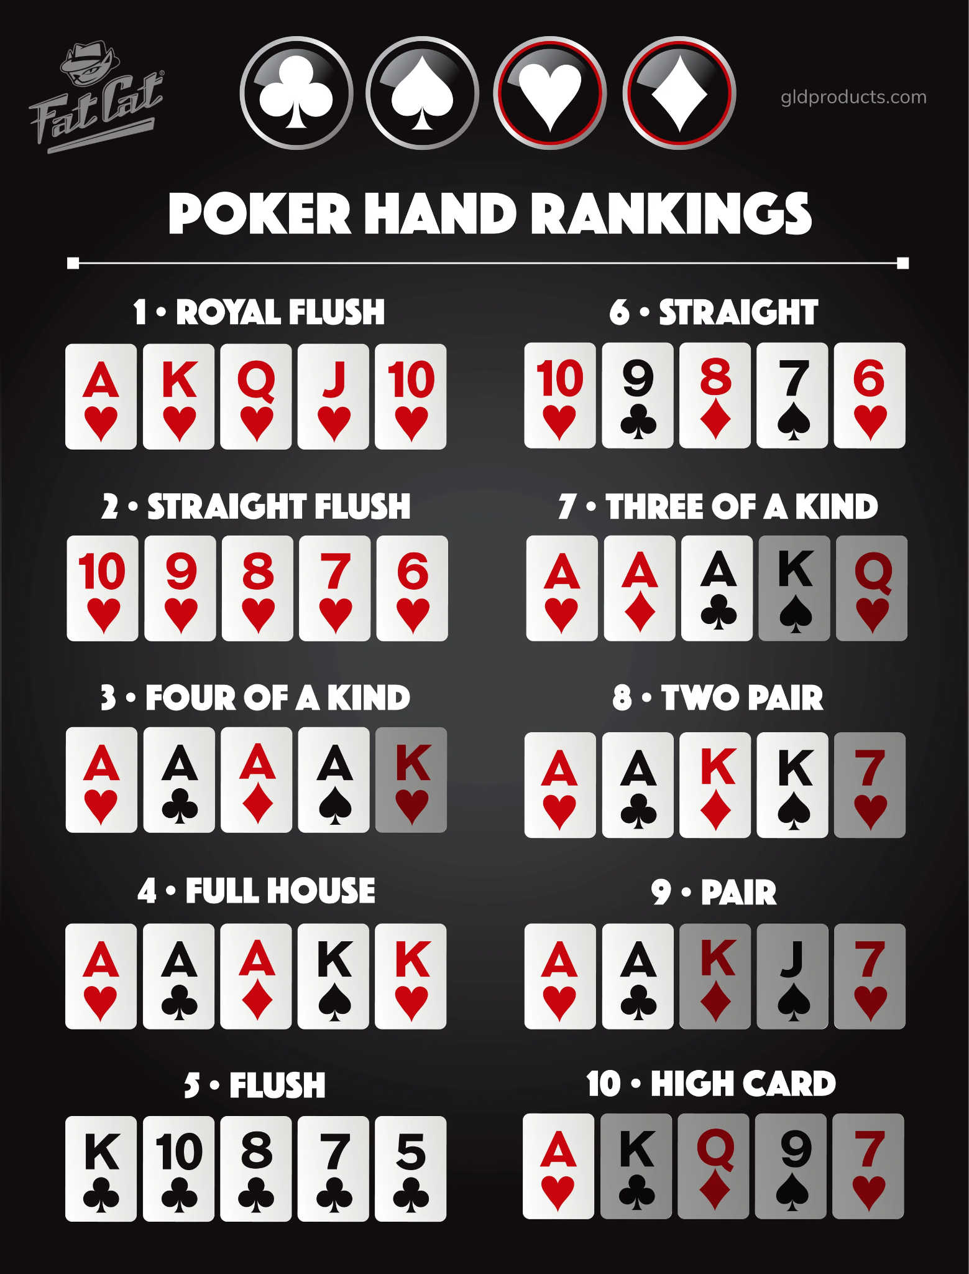

Slide 9
Poker!
Notes:
Idea:
We’ll write the platform to make and conduct trading strategies.
You guys will write and implement the strategies, test them on prior data
Alternate for more software-oriented people you guys could also make the platform
We can do this in python/C++, if python use numPy and Yahoo Finance data
Use matplotlib plot graphs, show that in pdf/md/html file through github

